Slide 1
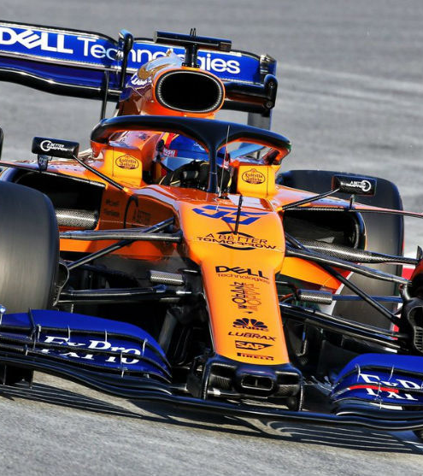
F1 Race Simulator Jay Bhavsar and Nathen Realmuto
This C++ simulation models a race between six current drivers in Formula One. It computes each driver's lap times and overall race duration by considering their high-speed racing skills, cornering abilities, and fatigue levels. Additionally, the simulation incorporates each car's speed, handling, and acceleration characteristics.
This Photo by Unknown Author is licensed under CC BY-NC-ND

